Slide 1

FINAL PROJECT SUBJECT : CST 3512 TOPIC :VISUALIZATION OF DATA FOR COOLING TOWER IN NYC

Slide 2
Cooling tower is designed to remove heat from a building or facility by spraying water down throw the tower to exchange heat into inside of the building. Air comes in from the sides of tower and passes through the water, Cooling towers are primarily used for the heating, ventilation, and air conditioning and industrial purpose. Cooling tower contains large amount of water and are potential breeding grounds for Legionella bacteria if they are not properly disinfected and maintained. Cooling tower registration in NYC is mandated by Local Law 77 of 2015. We will explore the data set and get some information about the cooling towers used in NYC.

Slide 3
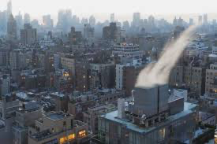
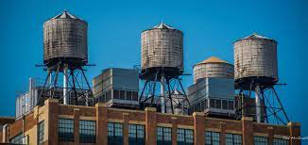
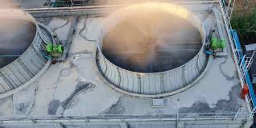
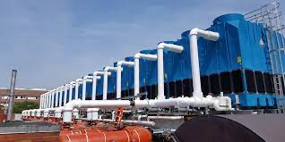
Some of Cooling towers in New York City

Slide 4
The original data set has total 6,241 rows and 22 columns, but many values are missing in each rows. Further analysis will be done using reduced data set.
The data set can be accessed using the link below.
https://drive.google.com/uc?export=download&id=1Igfusg_uVIzIXWJ1OlR62uYn2I1h2PsA
The cooling towers are mainly used for following purpose:
1. Base Building HVAC(Heating, Ventilation and Air Conditioning)
2.Air Conditioning
3.Condensate Water
4.Refrigration
The reduced data set contains 1446 rows which is very less than the original number, this implies that missing values in data affects the analysis.

Slide 5
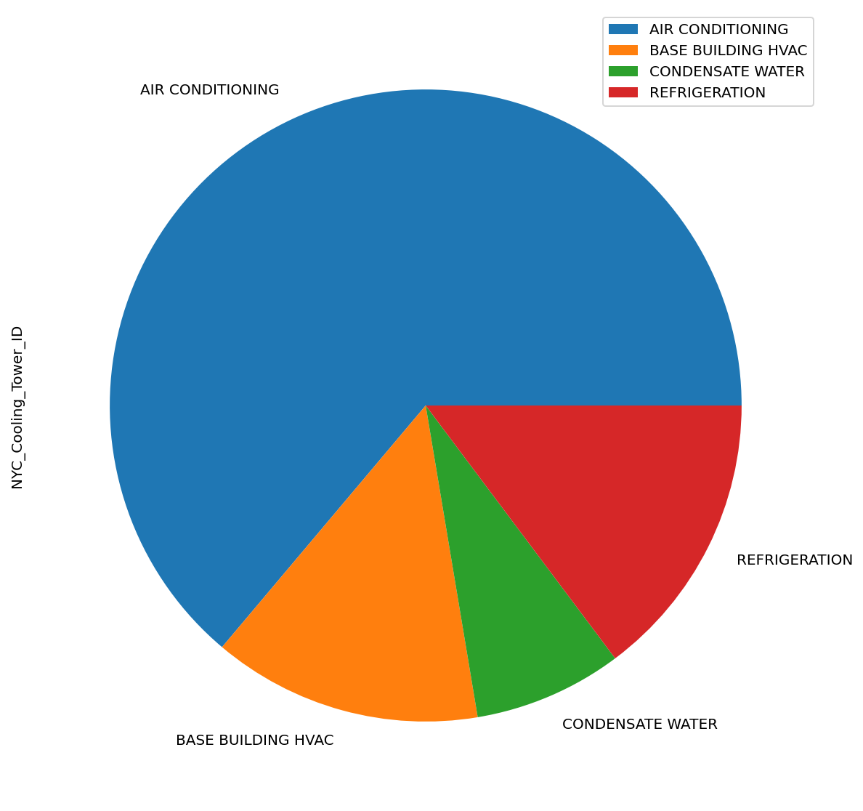
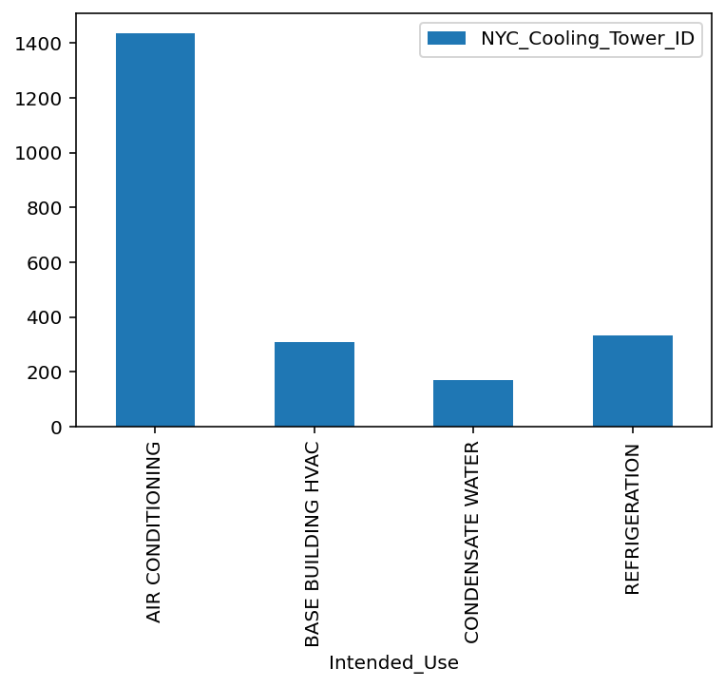

Slide 6
According to the reduced dataset there are about 38 different Make’s of cooling towers and some of most used are as follows:
1.Baltimore Aircoil Company
2.EVAPCO Corp
3.Marley
4.Phillips
5.Aqua Tower

Slide 7
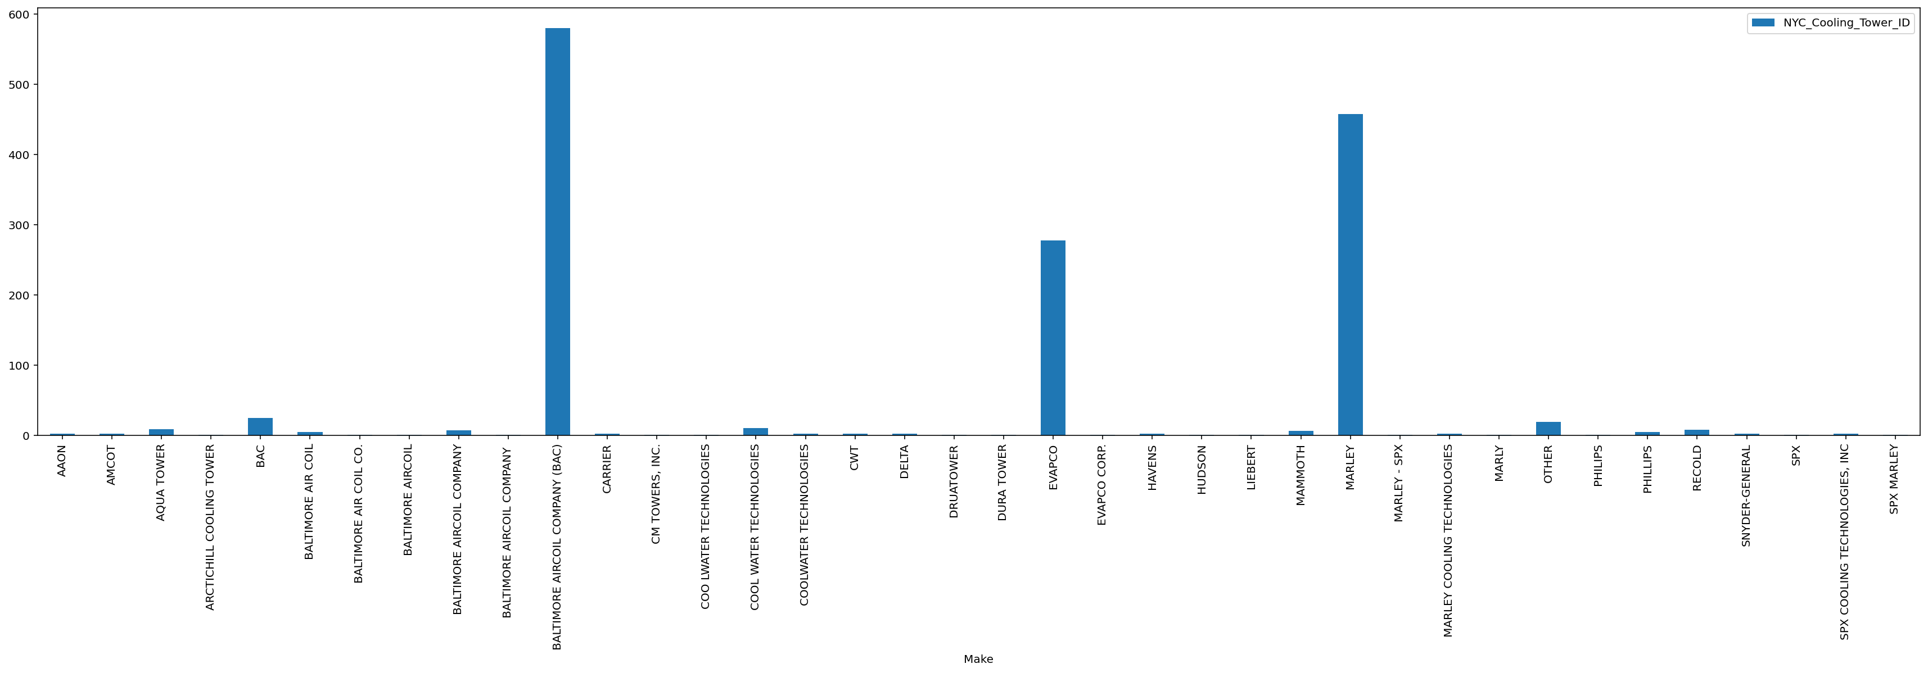
Bar Chart for different Makes used in Cooling Tower

Slide 8
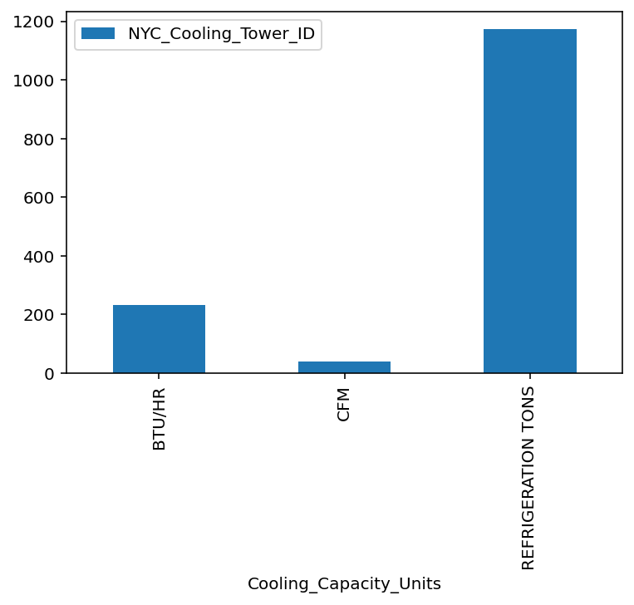
There are three C.C.U units used in these machine to measure cooling capacity.
1.BTU/HR(British Thermal Unit)
2.CFM(Cubic Feet per Minutes)
3.Refrigeration Tons(Rate of Heat Transfer)
The mostly used unit for cooling towers is Refrigeration Tons

Slide 9
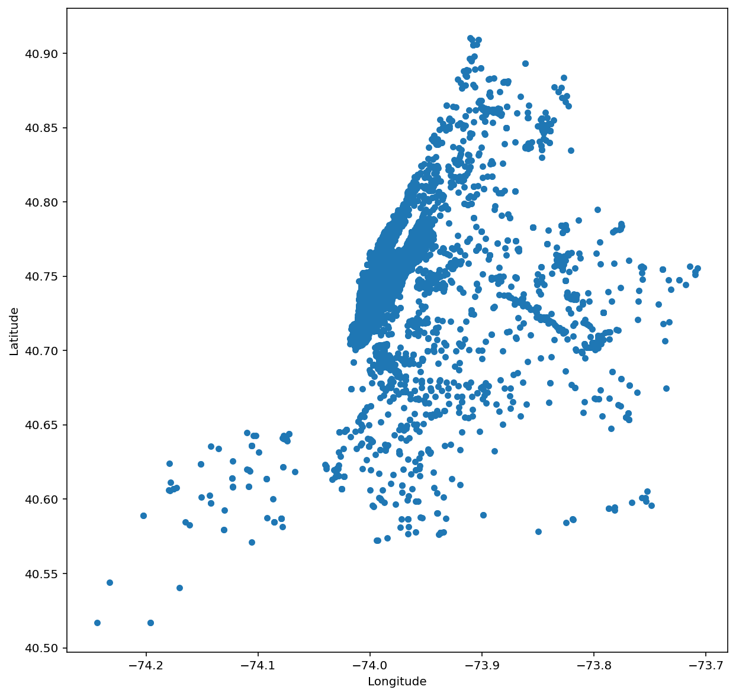
Scatter plot of the cooling tower locations to map NYC map for Original dataset

Slide 10
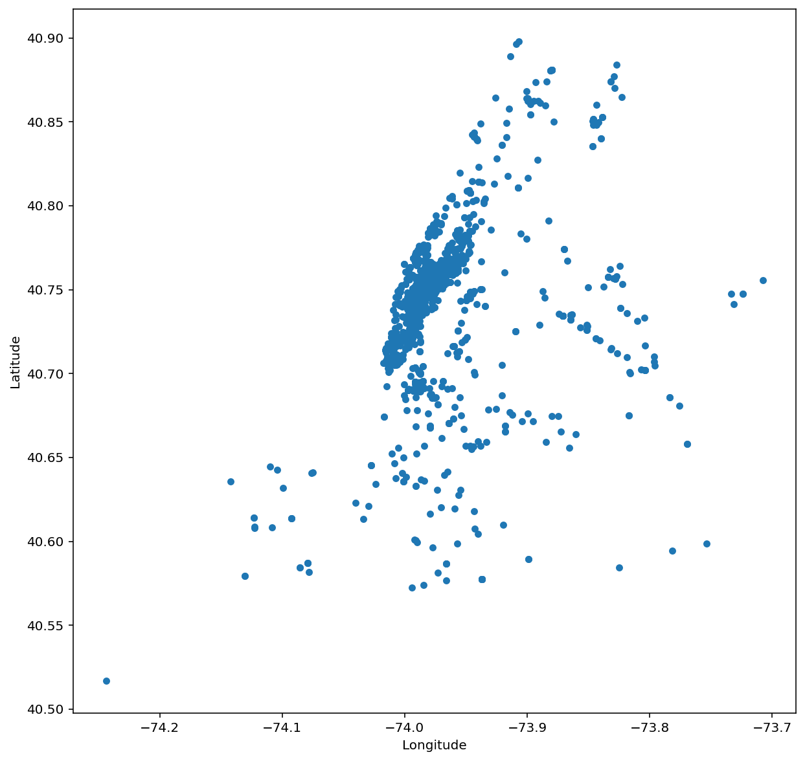
Scatter plot of the cooling tower locations to map NYC map for reduced dataset

Slide 11
In the original data set we can see that scatter plot is dense with many dots which is giving a good shape of NYC, but the second plot has the less scatter plot dots which makes the NYC map unclear and less meaningful. This concludes that accurate and total data is needed to make a proper conclusion and visualization.

Slide 12
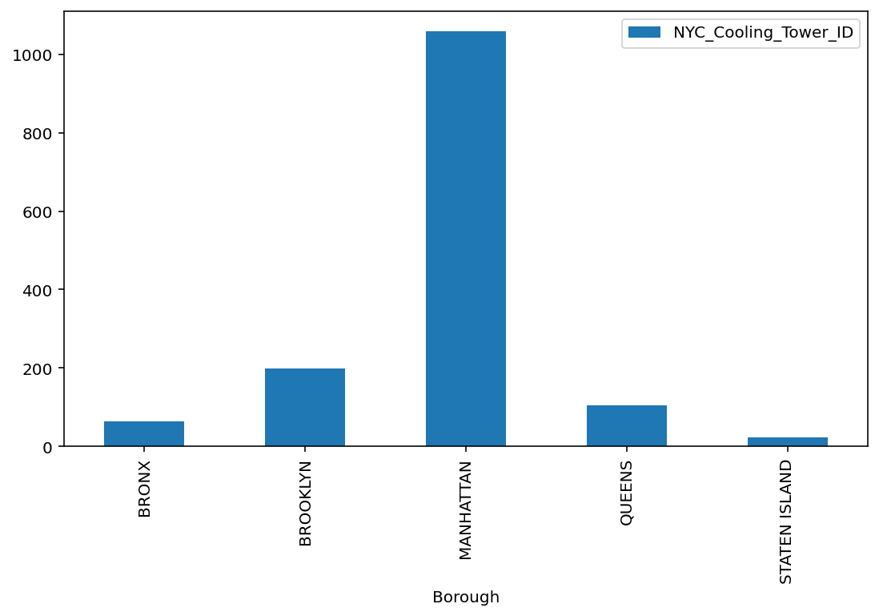
BRONX | 63
BROOKLYN | 198
MANHATTAN | 1058
QUEENS | 104
STATEN ISLAND | 23
BOROUGH
COUNT
Number of Cooling Towers by Borough
The reduced data set and chart shows that the Manhattan has the most numbers of Cooling Towers and Staten Island has least.

Slide 13
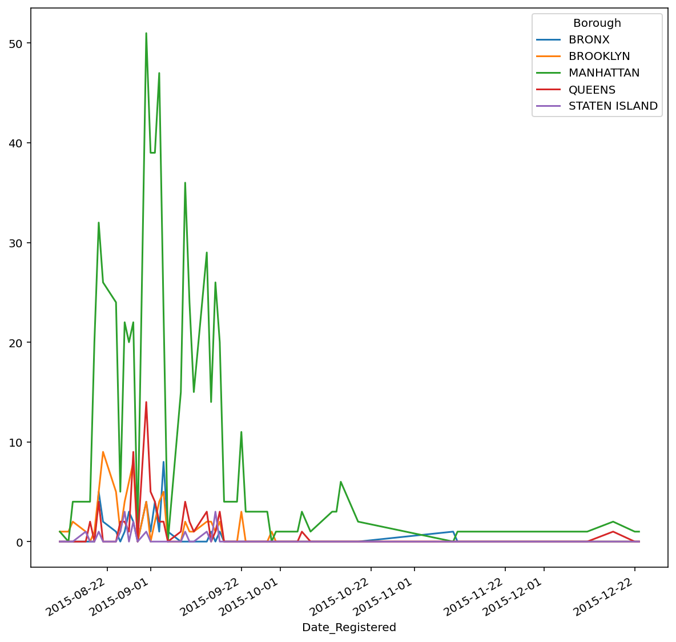
TIME SERIES ANALYSIS
Conclusion:
The time series graph shows that Manhattan has always highest number of registration from 2015-08-22 to 2015-12-22,
which I guess is the main city and many business and dense population might be the reason and and the Staten island
had the least registration. Brooklyn has the second highest registration during that period.

Slide 14
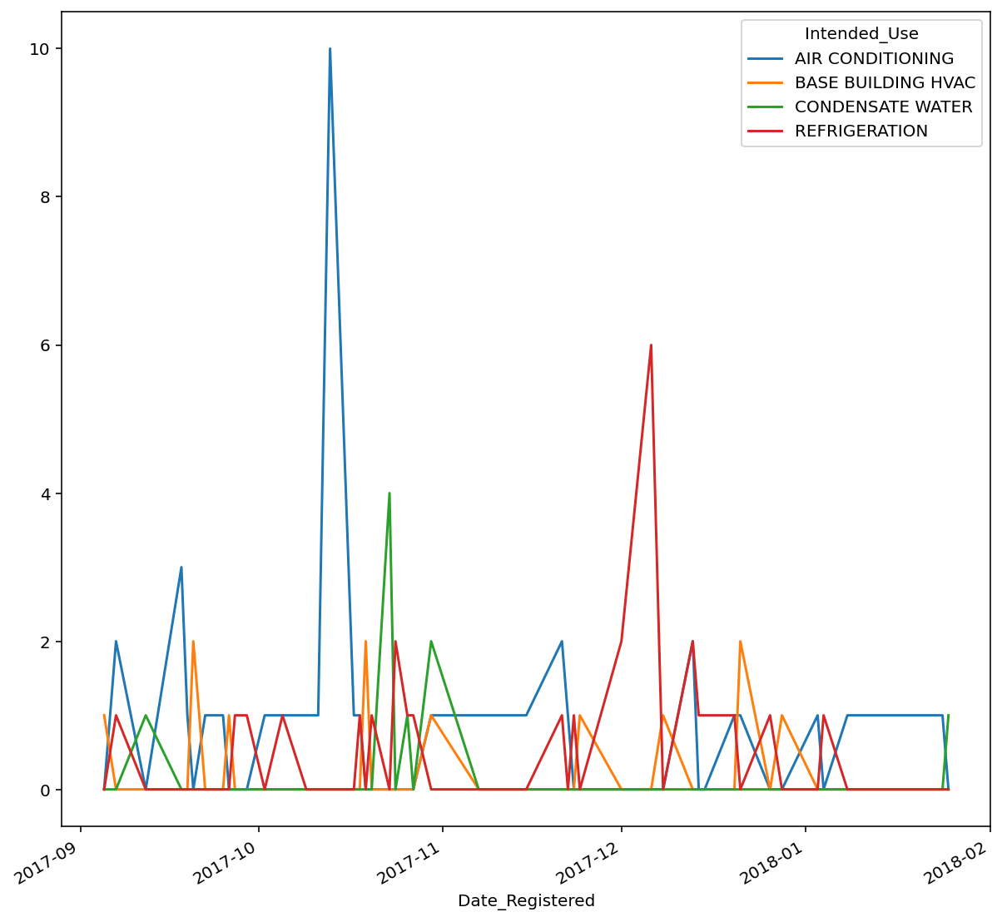
Time Series Analysis
The time series show that the registration of Air conditioning cooler tower was high from 2017-09 to 2017-11 and than small decline and the refrigeration cooling tower were registered mostly in 2017-12 to 2018-01

Slide 15
Lastly, all the Cooling Towers in NYC are plotted in NYC map using marker. Marker contains all the related information about each Cooling Towers like address, make, model, capacity, units, borough,
serial number and intended use. This folium map makes it easy for user to check respective location and get all the information related to Cooling Tower rather than sliding the whole data set.

Slide 16
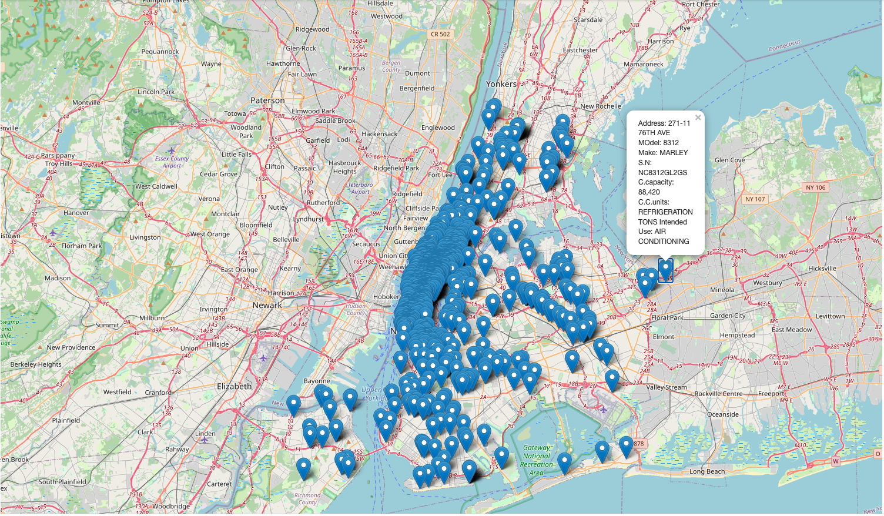
Plotting the Cooling Tower locations in NYC

Slide 17
Since, these Cooling Towers comes under the DOHMH, it is very necessary to keep record of each and every Cooling Towers present in NYC. The data set is missing many values for many rows, which affected the whole research, we were unable to get proper information about the each and every Cooling Towers. Respective individual and authorities using these facilities are required to maintain the proper information about the Cooling Towers Since, they posses the risk of water born disease, which affects the public health. Hopping to do the same research again with the new and complete data set in near future.
##########################THE END########################

